Slide 1
Microsoft
ENTERTAINMENT STUDIOS

Slide 2
Understanding the problem
HUGE REVENUE STREAM
MICROSOFT
RESOURCE ALLOCATION
Over the past decade movie revenues have blown up
Lots of money to be made
Wants to break into the industry
Has the capital
Doesn’t want to be exploring through trial and error
What do we put our money into
Horror Movies?
Leonardo DiCaprio?
Michael Bay?

Slide 3

OUR OBJECTIVE:
Determine which factors best predict a movie’s popularity

Slide 4
Process:
Brainstorm
Search for Data Sources
Collect Data
Exploratory Data Analysis
Clean Data
Hypothesize
Build visualizations

Slide 5
Draw conclusions
Ultimately
Do certain genres generate a greater profit margin?
Will movies starring a particular actor be more popular than without?
Are there any directors that produce higher quality movies?

Slide 6



Brainstorm, Search for Resources, Collect
Mehmet
Genre : Budget/Box Office revenue
Dave
Critic reviews based on director
Sam
User reviews Based on actors

Slide 7
Cleaning data and EDA
MySQL queries

Slide 8
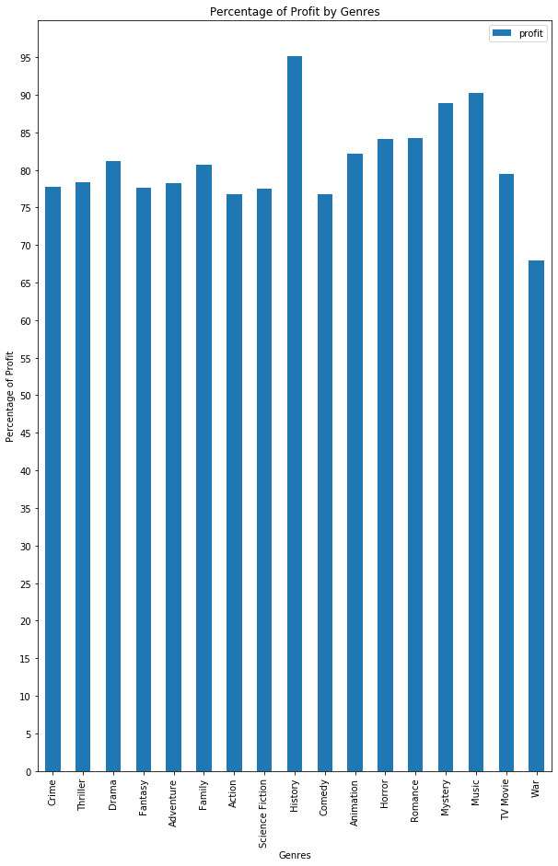
How much of the money generated was profit
divided by genre
Why would mystery and music genres show a greater profit margin?
Why would war movies have such a low profit margin?
History outlier

Slide 9
Actors who consistently star in well-received movies

Slide 10
Actors who consistently star in poorly-received movies

Slide 11
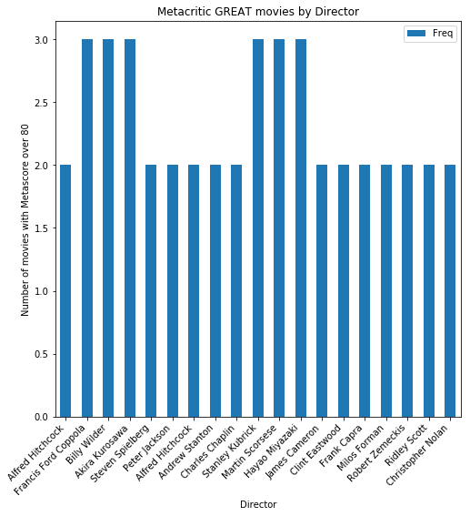
Which directors consistently make great movies?

Slide 12
In conclusion:
Lower cost-of-production (genres)
Martin Scorcese
Robert DiNero
Not Stephen Dorff

